Slide 1

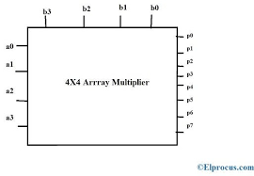
DESIGN AND VERIFY 4X4 MULTIPLIER
22WH1A0401 - SAI VIDHITHA
22WH1A0421 - GUNAVARDHINI
22WH1A0430 - KALLURI HANSIKA

Slide 2
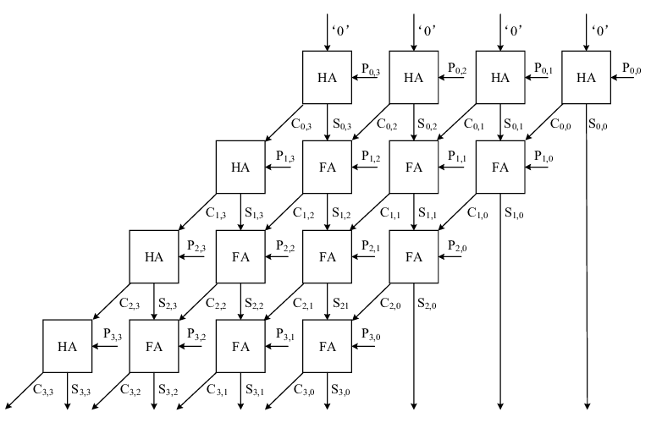
BLOCK DIAGRAM OF 4X4 MULTIPLIER

Slide 3
MULTIPLIER DESCRIPTION
1. The multiplier has two 4-bit inputs, A and B, with bits A0, A1, A2, A3 and B0, B1, B2, B3 from least significant to most significant.
2. The partial products P{i,j} are generated by ANDing each bit of A with each bit of B (P{i,j} = Ai ⋅ Bj)
3. These partial products are then accumulated using half adders (HAs) and full adders (FAs).
4. The first row consists of HAs, as it only needs to handle the initial partial products.
5. Each subsequent row starts with a HA followed by FAs to handle the carry bits from the previous row.
6. The carry outputs (C) from the HAs and FAs are propagated diagonally to the next row of adders.
7. The sum outputs (S) are propagated vertically down to the next row.
8. The rightmost column generates the final bits of the product (P) from the sums and carries.
9. The carries (C) in the last row contribute to the higher-order bits of the final product.
10. The process efficiently accumulates the partial products to form the final 8-bit product P0 to P7 with minimal delay, leveraging the carry-save adders ability to handle multiple carry bits simultaneously.

Slide 4
AGENDA
A 4x4 multiplier is a digital circuit used in computer arithmetic that multiplies two 4-bit binary numbers to produce an 8-bit binary result. It is a fundamental building block in digital signal processing, computer graphics, and many other fields requiring fast and efficient multiplication of binary numbers.
MOTIVATION
The motivation is to achieve efficient, accurate design and seamless integration using Synopsys tools for reliable 4x4 multiplier implementation.
OUR LEARNING JOURNEY
Technical Skills: Writing RTL codes, Testbenches, Scripting Synthesis Simulation.

Slide 5
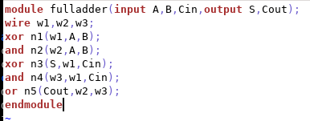
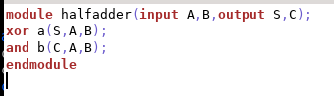
CODE FOR HALF ADDER AND FULL ADDER
STRUCTURAL STYLE:

Slide 6
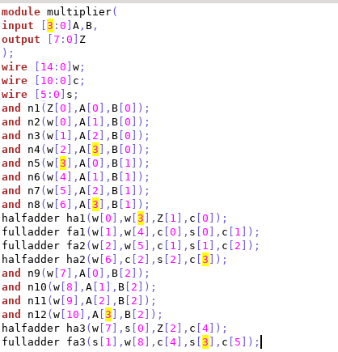
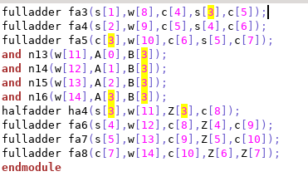
CODE FOR 4X4 MULTIPLIER
STRUCTURAL STYLE

Slide 7
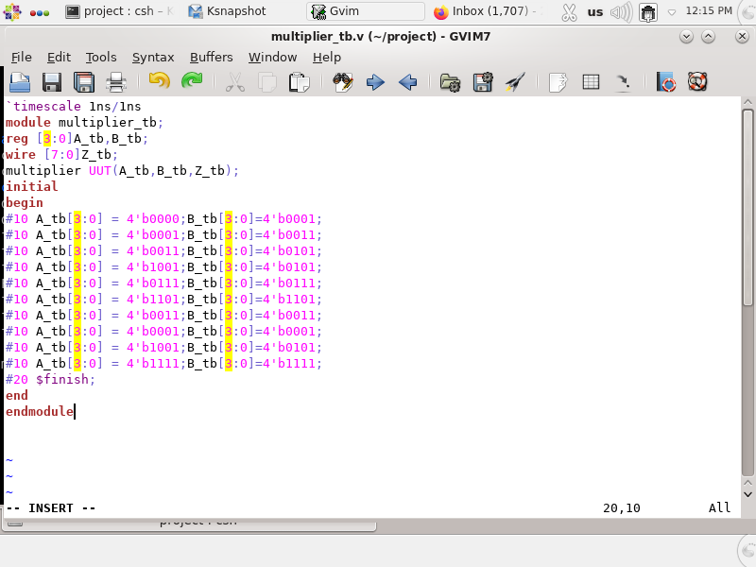
TESTBENCH FOR 4X4 MULTIPLIER
In each line of the testbench code, specific values are assigned to the inputs A_tb and B_tb of the multiplier module (referred to as UUT for Unit Under Test). This assignment occurs after waiting for 10 time units. This sequence of operations is crucial for testing the functionality of the multiplier module. By systematically changing the input values and observing the output at regular intervals, we can ensure the correctness and robustness of the multiplier design.

Slide 8
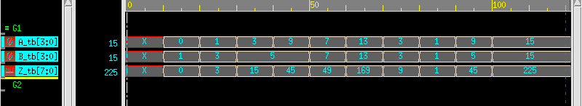
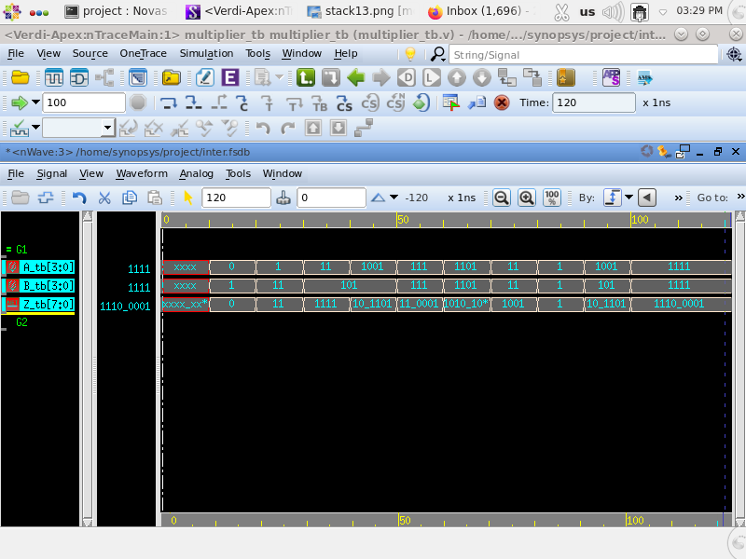
SIMULATION OUTPUTS
DECIMAL: **************************
BINARY:

Slide 9


SIMULATION OUTPUTS
OCTAL:
HEXADECIMAL:

Slide 10
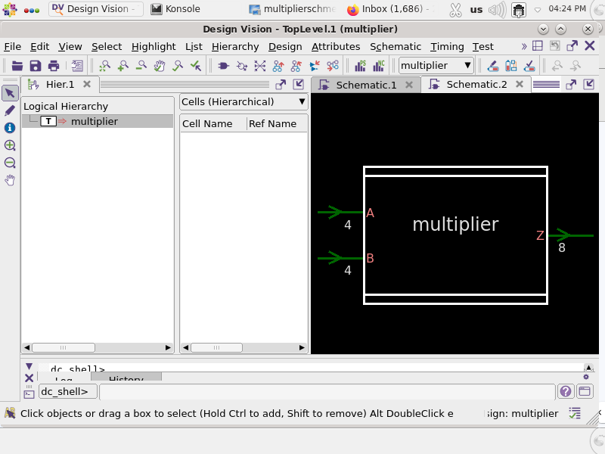
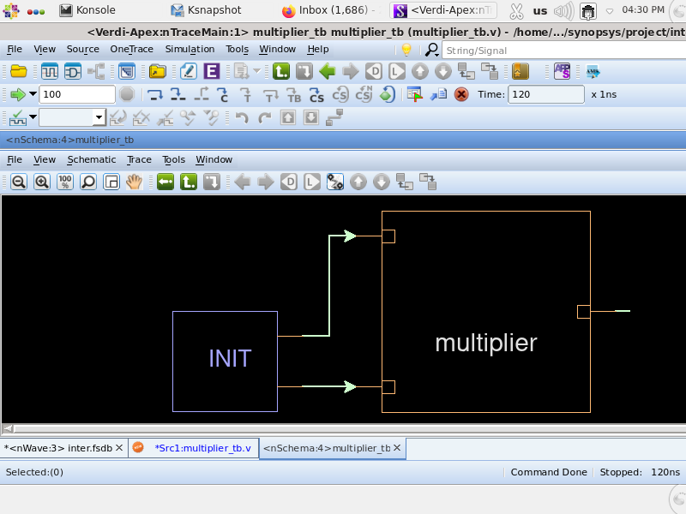
BLOCK DIAGRAM ********************
1. Initialization (`INIT` Block): The `INIT` block sets up the test inputs (A_tb and B_tb) for the multiplier.
2. Input Connections: The inputs from the `INIT` block are fed into the multiplier module via the arrows. These inputs represent the binary values to be multiplied.
3. Multiplication Operation: Inside the multiplier module, the input values (`A_tb` and `B_tb`) are multiplied together. The multiplier logic processes these inputs to generate a product.
4. Output Generation: The result of the multiplication (the product) is generated and sent out through the output connection. This output is then observed and verified against expected results to ensure the multiplier functions correctly.

Slide 11
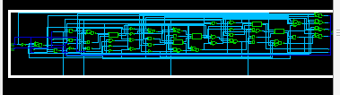
SCHEMATIC REPRESENTATION
The below circuit is designed to multiply two 4-bit numbers, producing an 8-bit product as output. The circuit consists of AND gates, Full Adders, and Half Adders that work together to perform the multiplication operation. The input numbers are fed into the circuit, and the AND gates produce partial products. These partial products are then added up by the Full Adders and Half Adders to produce the final 8-bit product.

Slide 12
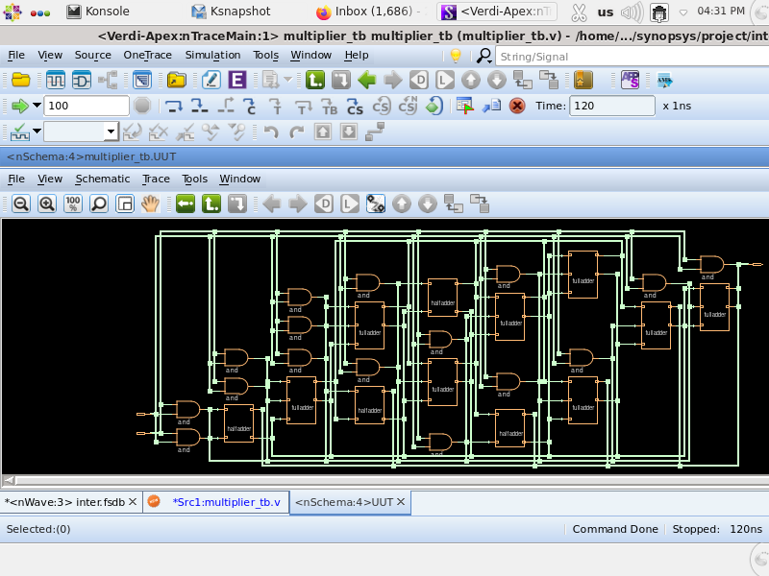
SCHEMATIC DIAGRAM **************

Slide 13
PERFORMANCE METRICS *****************
 |  | 32 or 28 nm technology |  |  | 14 nm technology
Tp |  | 10ns | 5ns | 2ns | 10ns | 5ns | 2ns
Slack | m1 | 8.51 | 3.51 | 0.53 | 9.19 | 4.19 | 1.19
 | m2 | 8.54 | 3.54 | 0.56 | 9.20 | 4.20 | 1.20
Pd | Static | 1.0114e + 06 pW | 1.0114e + 06 pW | 1.0114e + 06 pW | 274.7287 pW | 274.7287 pW | 274.7287 pW
 | Dynamic | 4.1540uW | 4.1540uW | 4.1679uW | 0.8979uW | 0.8979uW | 0.8979uW
 | Total | 13.6111uW | 13.6111uW | 13.7039uW | 1.3868uW | 1.3868uW | 1.3868uW
Area |  | 111.727170 | 111.727170 | 111.727170 | 26.106577 | 26.106577 | 26.106577

Slide 14
Thank You
Thank You

